Slide 1
TREES

Slide 2
Definition of tree
Tree data structure is a collection of data (Node) which is organized in hierarchical structure.
In tree data structure,
Every individual element is called as Node. Node, stores the actual data.
Link to next element in hierarchical structure.
If a tree has N number of nodes then maximum of N-1 number of links exists.

Slide 3
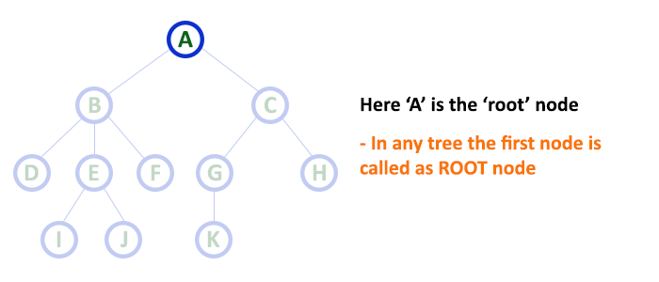
TREE TERMINOLOGY
ROOT NODE:
In a tree data structure,
The first node is called as Root Node.
Every tree must have root node.
Root node is the origin of tree data structure.
In any tree, there must be only one root node.
We never have multiple root nodes in a tree.

Slide 4
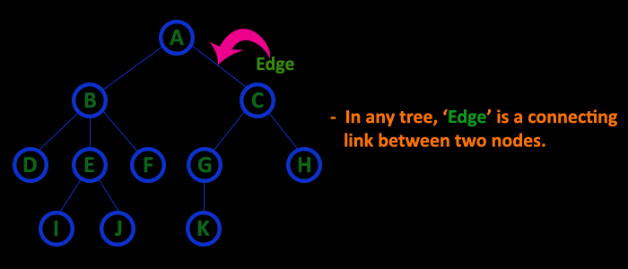
Edge
In a tree data structure, the connecting link between any two nodes is called as EDGE. In a tree with 'N' number of nodes there will be a maximum of 'N-1' number of edges.

Slide 5
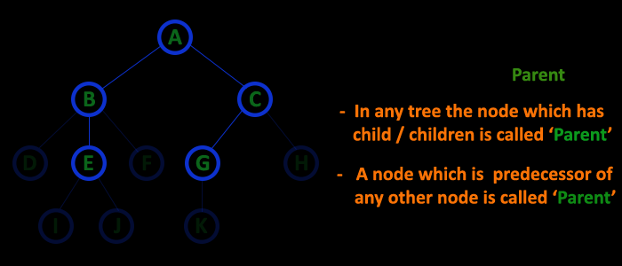
Parent
In a tree data structure, the node which is predecessor of any node is called as PARENT NODE. In simple words, the node which has branch from it to any other node is called as parent node. Parent node can also be defined as "The node which has child / children".

Slide 6
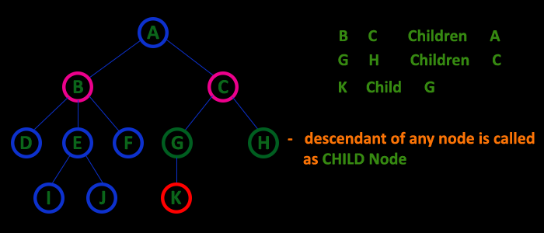
Child
In a tree data structure, the node which is descendant of any node is called as CHILD Node. In simple words, the node which has a link from its parent node is called as child node. In a tree, any parent node can have any number of child nodes. In a tree, all the nodes except root are child nodes.

Slide 7
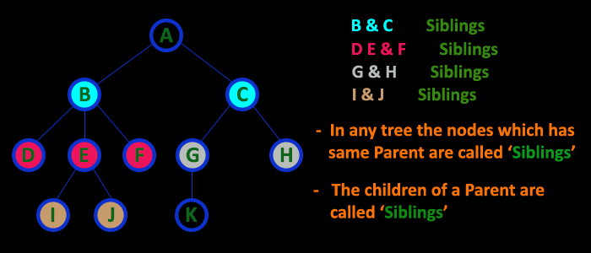
Siblings
In a tree data structure, nodes which belong to same Parent are called as SIBLINGS. In simple words, the nodes with same parent are called as Sibling nodes.

Slide 8
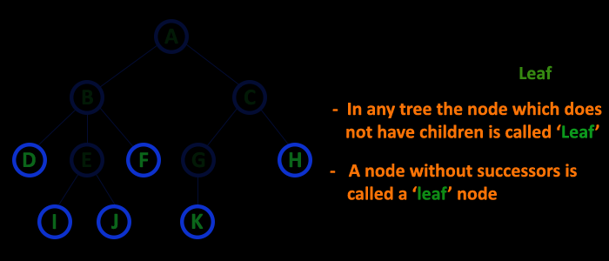
Leaf
In a tree data structure, the node which does not have a child is called as LEAF Node. In simple words, a leaf is a node with no child. In a tree data structure, the leaf nodes are also called as External Nodes. External node is also a node with no child. In a tree, leaf node is also called as 'Terminal' node.

Slide 9
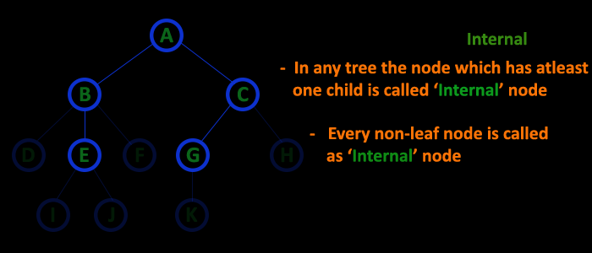
7. Internal Nodes
In a tree data structure, the node which has atleast one child is called as INTERNAL Node. In simple words, an internal node is a node with atleast one child. In a tree data structure, nodes other than leaf nodes are called as Internal Nodes. The root node is also said to be Internal Node if the tree has more than one node. Internal nodes are also called as 'Non-Terminal' nodes.

Slide 10
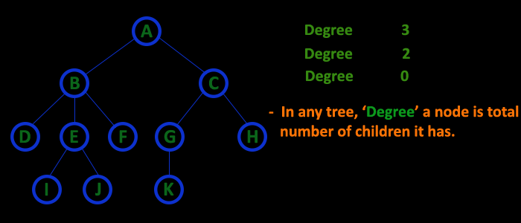
Degree
In a tree data structure, the total number of children of a node is called as DEGREE of that Node. In simple words, the Degree of a node is total number of children it has. The highest degree of a node among all the nodes in a tree is called as 'Degree of Tree'

Slide 11
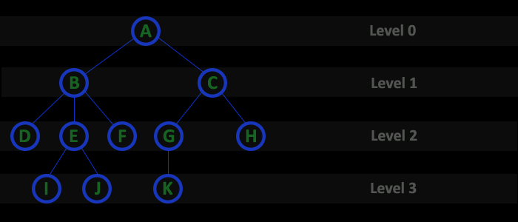
Level
In a tree data structure, the root node is said to be at Level 0 and the children of root node are at Level 1 and the children of the nodes which are at Level 1 will be at Level 2 and so on... In simple words, in a tree each step from top to bottom is called as a Level and the Level count starts with '0' and incremented by one at each level (Step).

Slide 12
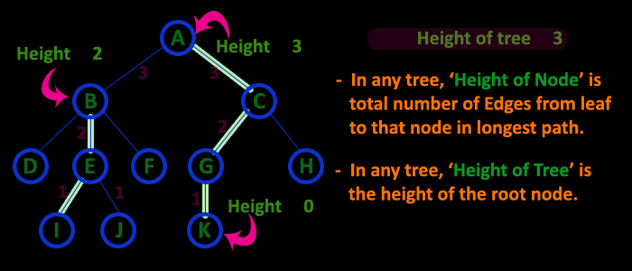
Height
In a tree data structure, the total number of egdes from leaf node to a particular node in the longest path is called as HEIGHT of that Node. In a tree, height of the root node is said to be height of the tree. In a tree, height of all leaf nodes is '0'.

Slide 13
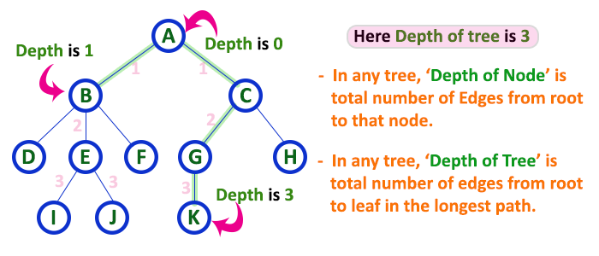
Depth
In a tree data structure, the total number of egdes from root node to a particular node is called as DEPTH of that Node. In a tree, the total number of edges from root node to a leaf node in the longest path is said to be Depth of the tree. In simple words, the highest depth of any leaf node in a tree is said to be depth of that tree. In a tree, depth of the root node is '0'.

Slide 14
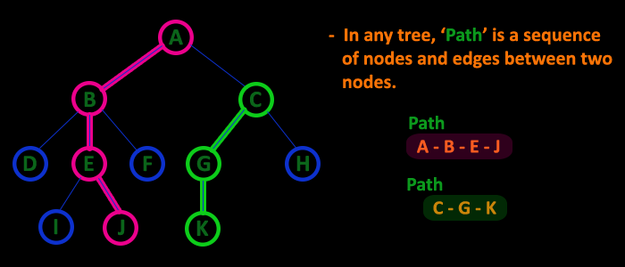
Path
In a tree data structure, the sequence of Nodes and Edges from one node to another node is called as PATH between that two Nodes. Length of a Path is total number of nodes in that path. In below example the path A - B - E - J has length 4.

Slide 15
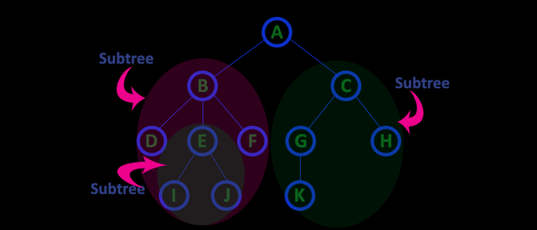
Sub Tree
In a tree data structure, each child from a node forms a subtree recursively. Every child node will form a subtree on its parent node.

Slide 16
TYPES OF TREES
Trees are classified as
Binary tree.
Complete binary tree.
Binary search tree.

Slide 17
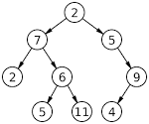
BINARY TREE:
A tree in which every node can have a maximum of two children is called as Binary Tree.
In a binary tree, every node can have either 0 or 1 child or 2 children, but not more than 2 children.

Slide 18
There are different types of binary trees and they are:
Strictly Binary Tree
A binary tree in which every node has either two or zero number of children is called Strictly Binary Tree.
That means every internal node must have exactly two children.
Strictly binary tree is also called as Full Binary Tree or Proper Binary Tree or 2-Tree.
Strictly binary tree data structure is used to represent mathematical expressions.

Slide 19
Complete Binary Tree
A binary tree in which every internal node has exactly two children and all leaf nodes are at same level is called Complete Binary Tree.
Complete binary tree is also called as Perfect Binary Tree.

Slide 20
Construct the binary tree and perform traversal:
1. Pre order: 1 2 4 5 3
Post order: 4 5 2 3 1.
2. ab+cd-*ef+/.
Post order: ACEDBHIGF
Inorder: ABCDEFIGH
Pre order: FBADCEGIH.
3. Post order: DFEBGLJKHCA
Inorder: DBFEAGCLJHK
4. Preorder: ABDEFCGHJLK
Inorder: DBFEAGCLJHK.
5. Pre order: 1 2 3 5 8 9 6 10 4 7
In order: 2 1 8 5 9 3 10 6 7 4

Slide 21
6. In order: 4 8 2 5 1 6 3 7
Post order: 8 4 5 2 6 7 3 1.
7. Pre order: 3 9 20 15 7
In order: 9 3 15 20 7.
8. Pre order: 1 2 4 5 3 6
In order: 4 2 5 1 3 6
9. Pre order: a b d c e g f.
In order: d b a e g c f
10. Pre order:1 2 3 4 5 7 8 9 6
In order: 2 3 1 7 5 9 8 4 6.
11. Post order:8 9 4 5 2 6 7 3 1
Pre order: 1 2 4 8 9 5 3 6 7

Slide 22
12. Post order: G K H D B E F C A
Pre order: A B D G H K C E F.
13. Pre order: A B D E C F
Post order: D E B F C A.
14. Pre order: A B D G H K C E F
Post order: G K H D B E F C A.
15. In order : GDHBAEICF
Post order : GHBDIEFCA
16. In order : DCEBAGFHI
Pre order : ABCDEFGHI
17. In order : GDBEHACF
Post order : GDHEBFCA
18. Post order: 9,1,2,12,7,5,3,11,4,8.
Inorder: 9,5,1,7,2,12,8,4,3,11.
19. In order : 4,8,2,5,1,6,3,7
Post order : 8,4,5,2,6,7,3,1
Binary Search tree:
56 38 10 65 72 44 50 .

Slide 23
When pre order and post order traversal given to construct the binary tree then,
In post order traversal, immediate predecessor of the root node is the right child of the root node.
In pre order traversal, immediate successor of the root node is the left child of the root node.
If both predecessor and successor node are same, then tree cannot be unique.
In pre order, in between left and right child of the root node, all the elements belong to left sub tree and after right child, all the elements belong to right sub tree.

Slide 24
Example:
Pre order: ABDGHKCEF
Post order:GKHDBEFCA.
In Pre order always the first node and in post order always last node is Root node so, A is the root node.
The immediate successor of root node A in Pre order is the left child ie. B.
The immediate predecessor of root node A in Post order is the right child ie. C.
A
B

Slide 25
Binary Search Tree
A Binary Search Tree (BST) is a tree in which all the nodes follow some properties:
The left sub-tree of a node has a key less than or equal to its parent node's key.
The right sub-tree of a node has a key greater than to its parent node's key.
Thus, BST divides all its sub-trees into two segments; the left sub-tree and the right sub-tree and can be defined as −
left_subtree (keys) ≤ node (key) ≤ right_subtree (keys)

Slide 26
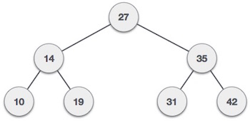
Binary Search Tree
There are three types of binary tree traversals.
In - Order Traversal
Pre - Order Traversal
Post - Order Traversal

Slide 27
Binary Tree Traversal
Displaying (or) visiting order of nodes in a binary tree is called as Binary Tree Traversal.
Preorder traversal sequence : root, left, right.
Inorder traversal sequence : left, root, right.
Postorder traversal sequence: left, right, root.

Slide 28
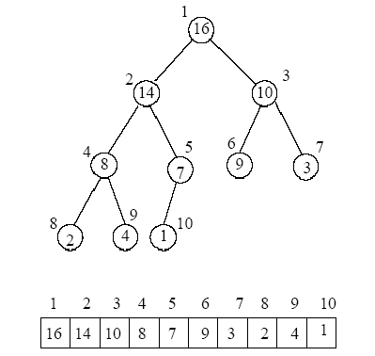
A binary tree is represented using two methods.
Array Representation.
Linked list Representation.

